Slide 1
Blockchain Technology 2
Beni Iyaka H00181266
bi34@hw.ac.uk
MSc Software Engineering
2016 - 2017

Slide 2
Outline
Overview
Objectives of the internet
Blockchain vs Internet
Internet
Blockchain
Bitcoin
Bitcoin Transaction
Further Readings

Slide 3


Blockchain Technology
the second coming
of
the Internet

Slide 4
Overview

Slide 5
Before talking about how blockchain is competing with the internet, let's first talk about the internet.
Internet was created in 1958 in America.
Internet began to grow in 1970 as the knowledge of networking was growing more and more rapidly.
Internet allows people to send and receive data wherever they are in the world if they have internet access.
Afuah, A. and Tucci, C.L., 2000. Internet business models and strategies: Text and cases. McGraw-Hill Higher Education.

Slide 6
Objectives
of
The internet

Slide 7
The main purpose of the Internet is offering effective information sharing and communication globally using computers. Notably, the Internet is the biggest player in the realization of the concept of globalization today. With the Internet, the world has become a global village.
The internet in our day is used for many different things such as:
Online shopping.
Watching videos.
Research.
Downloading or listening to music.
Afuah, A. and Tucci, C.L., 2000. Internet business models and strategies: Text and cases. McGraw-Hill Higher Education.

Slide 8
Blockchain
Vs
Internet

Slide 9
With the internet technology, data is shared at the application layer and not the protocol level.
With internet technology, many applications have become valuable by capturing data from users. Because this fata is isolated, therefore valuable.
Blockchain technology acts the opposite. The network runs on the protocol layer.
Blockchain technology is based on shared information;which means that the shared information is not very valuable because everybody has it.

Slide 10
The internet
Application
Application Protocol
Application Low

Slide 11
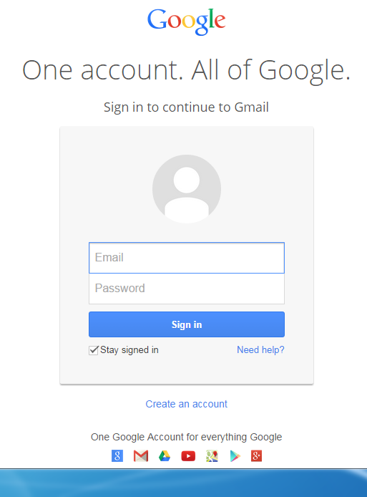
Application
Application Protocol
Application Low
SMTP
IMAP
POP3
TCP/IP
Source: www.gmail.com

Slide 12
Application
Gmail which stands for Google Mail, this is one of the internet application.
Gmail was released on April first 2004.
This is used for mailing conversation and adverts email service developed by Google.
Arrington, M., 2006. Gmail disaster: Reports of mass email deletions.

Slide 13

Application
Gmail which stands for Google Mail, this is one of the internet application.
Gmail was released on April first 2004.
This is used for mailing conversation and adverts email service developed by Google.
Arrington, M., 2006. Gmail disaster: Reports of mass email deletions.

Slide 14
Application Protocol
This is a mechanism that help govern communication on the internet network through various protocols.
SMTP stands for Simple Mail Transfer Protocol.
SMTP is an internet protocol standards for electronic mail transmission.
SMTP is used for sending and receiving mail.
Arrington, M., 2006. Gmail disaster: Reports of mass email deletions.

Slide 15
Application Protocol
But very limited when it comes to queuing messages at the receiving end.
That’s why SMTP uses POP3 or IMAP so as to allow the user to save the messages in the server.
POP3 stands for Post Office Protocol 3.
POP3 is known to be the most recent standard protocol used for receiving emails.
Arrington, M., 2006. Gmail disaster: Reports of mass email deletions.

Slide 16
Application Protocol
POP3 is a protocol used by both client and server end.
POP3 allows the user to receive and save the email in the internet server.
IMAP stands for Internet Message Access Protocol.
IMAP is a standard email protocol that helps retrieve email messages on a mail server.
Arrington, M., 2006. Gmail disaster: Reports of mass email deletions.

Slide 17
Application Low
The google mail uses TCP/IP to enable better transmission of mail from the sender to the receiver.
TCP/IP
This is a two layer program.
The top layer is Transmission Control Protocol layer and the bottom layer is Internet Protocol.
Arrington, M., 2006. Gmail disaster: Reports of mass email deletions.

Slide 18
Transmission Control Protocol helps manage the assembling of a message into small packets.
Those packets are then transmitted over the internet and then received by a TCP layer that reassembles the packet into the original message.
The Internet Protocol handles the address part of each packet so as to make sure that they get to the right destination.
Arrington, M., 2006. Gmail disaster: Reports of mass email deletions.

Slide 19
Blockchain

Slide 20
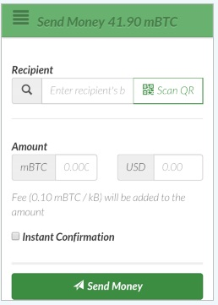
Application
Application Protocol
Application Low
Bitcoin Protocol
Ethereum Protocol
Chain Block Protocol
Source: www.greencoin.com

Slide 21

Arrington, M., 2006. Gmail disaster: Reports of mass email deletions.

Slide 22
Overview

Slide 23
Bitcoin is an innovative payment network and a new kind of money.
Bitcoin, the online, digital currency and also the internet of money.
Bitcoin uses peer-to-peer technology to operate with no central authority or banks
Nakamoto, S., 2008. Bitcoin: A peer-to-peer electronic cash system.

Slide 24
Bitcoin is an innovative payment network and a new kind of money.
Bitcoin, the online, digital currency
Bitcoin uses peer-to-peer technology to operate with no central authority or banks
Bitcoin is open-source; its design is public, nobody owns or controls
Nakamoto, S., 2008. Bitcoin: A peer-to-peer electronic cash system.

Slide 25
Bitcoin is open-source; its design is public.
Nobody owns or controls it.
Bitcoin is the first successful implementation of a distributed crypto-currency, described in part in 1998 by Wei Dai
In 2007, Satoshi Nakamoto began working on the Bitcoin although Craig Steven Wright claims to be the real person behind the pseudonym.
Nakamoto, S., 2008. Bitcoin: A peer-to-peer electronic cash system.

Slide 26
In 2008, Nakamoto published the first design paper. And Bitcoin.org was registered.
In 2013, the first Bitcoin ATM in the world is debuted in San Diego and california.
Bitcoin is a peer to peer network that maintains a public decentralised ledger of digital math based assets.
Bitcoin is an open source cryptocurrency.
Nakamoto, S., 2008. Bitcoin: A peer-to-peer electronic cash system.

Slide 27
Bitcoin can be categorised as a distributed accounting system.
In bitcoin, the transaction is verified through the proof-of-work system of computers running a mining software
Nakamoto, S., 2008. Bitcoin: A peer-to-peer electronic cash system.

Slide 28
Bitcoins can easily be sent through the internet without the need of the third party.
The supply of bitcoins is regulated by software.
The agreement of users of the system and cannot be manipulated by any government, bank, organization or individual.
Nakamoto, S., 2008. Bitcoin: A peer-to-peer electronic cash system.

Slide 29
Bitcoin transactions are irreversible by design.
They are fast.
Funds received are available for spending within minutes
Cost very little, especially compared to other payment networks
Nakamoto, S., 2008. Bitcoin: A peer-to-peer electronic cash system.

Slide 30
In Bitcoin, anonymity and traceability are user defined. This means that the counterparty can be anonymous as they take steps to be even to each other.
All the transfers in Bitcoins consist not of physically moving on object from A to B but simply by adding a new and publicly accepted transaction to the blockchain.
Nakamoto, S., 2008. Bitcoin: A peer-to-peer electronic cash system.

Slide 31
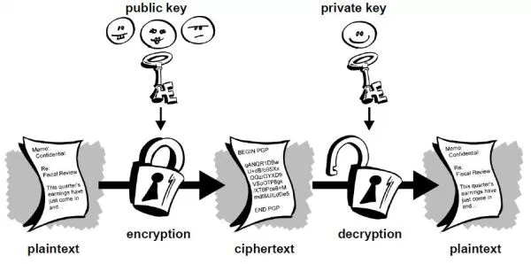
What Do Bitcoins look like?
Nakamoto, S., 2008. Bitcoin: A peer-to-peer electronic cash system.

Slide 32

Public Key
This is also known as address. This key is known by other users. It is 34 characters long starting with 1 or 3 which represent a possible destination for payment.
Example of a public key:
1FfmbHfnpaZjKFvyi1okTjJJusN455paPH
Shamir, A., 1984, August. Identity-based cryptosystems and signature schemes. In Workshop on the Theory and Application of Cryptographic Techniques (pp. 47-53). Springer Berlin Heidelberg.

Slide 33

Private key
This is only known by the owner. It is 51 characters long starting with 5. This key is required to transfer value from the address.
Example of a private key:
5J4UA9wdxyicQgjAyMZUazcwwAf6Lz3afTcSXxi4fSpQmeXRQdY
Shamir, A., 1984, August. Identity-based cryptosystems and signature schemes. In Workshop on the Theory and Application of Cryptographic Techniques (pp. 47-53). Springer Berlin Heidelberg.

Slide 34
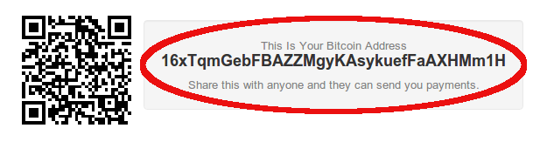
Address
A Bitcoin address is similar to a physical address or an email
A Bitcoin Address is derived by a ECDSA (Elliptic Curve Digital Signature Algorithm) Public Key by using hash functions.
Shamir, A., 1984, August. Identity-based cryptosystems and signature schemes. In Workshop on the Theory and Application of Cryptographic Techniques (pp. 47-53). Springer Berlin Heidelberg.

Slide 35
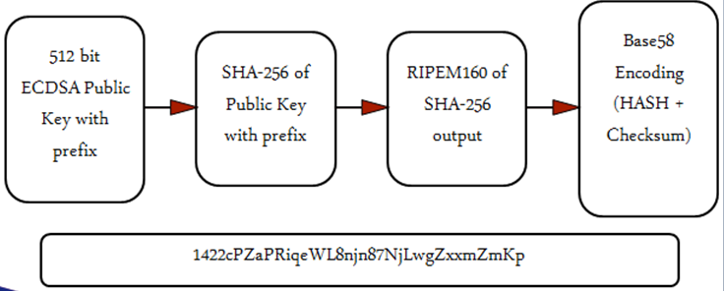
Shamir, A., 1984, August. Identity-based cryptosystems and signature schemes. In Workshop on the Theory and Application of Cryptographic Techniques (pp. 47-53). Springer Berlin Heidelberg.

Slide 36
Application protocol

Slide 37

Bitcoin Protocol
This is also known as Cryptographic protocol.
This protocol handles security based functions and applies cryptographic methods to it.
Barber, S., Boyen, X., Shi, E. and Uzun, E., 2012, February. Bitter to better—how to make bitcoin a better currency. In International Conference on Financial Cryptography and Data Security (pp. 399-414). Springer Berlin Heidelberg.

Slide 38
Ethereum Protocol
This is an open platform that lets anyone build and use decentralized applications that runs on blockchain technology.
This is an open-source project built by many people around the world.
Contrary to bitcoin, ethereum was designed to be adaptable and flexible.
Barber, S., Boyen, X., Shi, E. and Uzun, E., 2012, February. Bitter to better—how to make bitcoin a better currency. In International Conference on Financial Cryptography and Data Security (pp. 399-414). Springer Berlin Heidelberg.

Slide 39
Bitcoin Transaction

Slide 40
Transactions let users spend satoshis
A Satoshi is the smallest fraction of a Bitcoin that can currently be sent: 0.00000001 BTC
There are two types of transactions
Coinbase transactions
New Bitcoins are introduced into the system
In every block as the very first transaction
reward for solving a proof-of-work problem
Regular transactions
Are used to transfer existing Bitcoins amongst different accounts
Barber, S., Boyen, X., Shi, E. and Uzun, E., 2012, February. Bitter to better—how to make bitcoin a better currency. In International Conference on Financial Cryptography and Data Security (pp. 399-414). Springer Berlin Heidelberg.

Slide 41
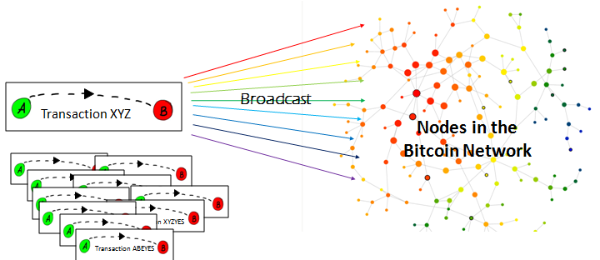
Barber, S., Boyen, X., Shi, E. and Uzun, E., 2012, February. Bitter to better—how to make bitcoin a better currency. In International Conference on Financial Cryptography and Data Security (pp. 399-414). Springer Berlin Heidelberg.

Slide 42
Each transaction is prefixed by a four-byte transaction version number
Bitcoin peers and miners which set of rules to use to validate it
Each transaction has at least one input and one output
Each input spends the satoshis paid to a previous output.
Each output then waits as an Unspent Transaction Output (UTXO) until a later input spends it
Barber, S., Boyen, X., Shi, E. and Uzun, E., 2012, February. Bitter to better—how to make bitcoin a better currency. In International Conference on Financial Cryptography and Data Security (pp. 399-414). Springer Berlin Heidelberg.

Slide 43
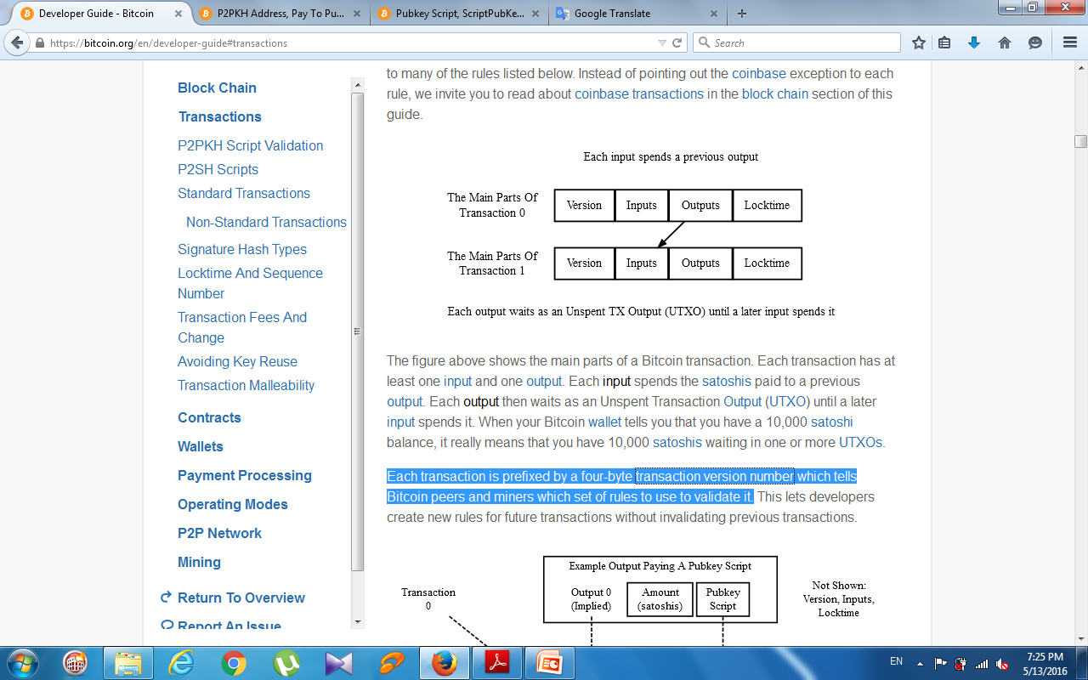
Barber, S., Boyen, X., Shi, E. and Uzun, E., 2012, February. Bitter to better—how to make bitcoin a better currency. In International Conference on Financial Cryptography and Data Security (pp. 399-414). Springer Berlin Heidelberg.

Slide 44
An input uses a transaction identifier (txid)
And an output index number (often called “vout” for output vector) to identify a particular output to be spent
It also has a signature script which allows it to provide data parameters that satisfy the conditionals in the pubkey script
Barber, S., Boyen, X., Shi, E. and Uzun, E., 2012, February. Bitter to better—how to make bitcoin a better currency. In International Conference on Financial Cryptography and Data Security (pp. 399-414). Springer Berlin Heidelberg.

Slide 45
An output has an implied index number based on its location in the transaction
The output also has an amount in satoshis which it pays to a conditional pubkey script
Anyone who can satisfy the conditions of that pubkey script can spend up to the amount of satoshis paid to it
Barber, S., Boyen, X., Shi, E. and Uzun, E., 2012, February. Bitter to better—how to make bitcoin a better currency. In International Conference on Financial Cryptography and Data Security (pp. 399-414). Springer Berlin Heidelberg.

Slide 46
Further readings
https://bitsonblocks.net/2016/02/01/a-gentle-introduction-to-smart-contracts/
https://bitsonblocks.net/2016/05/09/confused-by-blockchains-revolution-vs-evolution/
https://bitsonblocks.net/2015/12/01/the-pros-and-cons-of-internal-blockchains/

Slide 47
Further readings
https://bitsonblocks.net/2015/09/28/a-gentle-introduction-to-digital-tokens/
https://bitsonblocks.net/2015/09/21/a-gentle-introduction-to-bitcoin-mining/
https://bitsonblocks.net/2016/02/01/a-gentle-introduction-to-smart-contracts/

